Slide 1
Filling Out renewal application

Slide 2
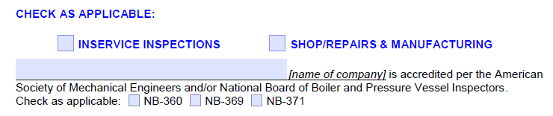

Filling out Application
If you are strictly only performing Inservice Inspections
If you are performing both, Inservice Inspections and Shop, Repairs or Manufacturing
If you are strictly only performing Shop, Repairs or Manufacturing

Slide 3
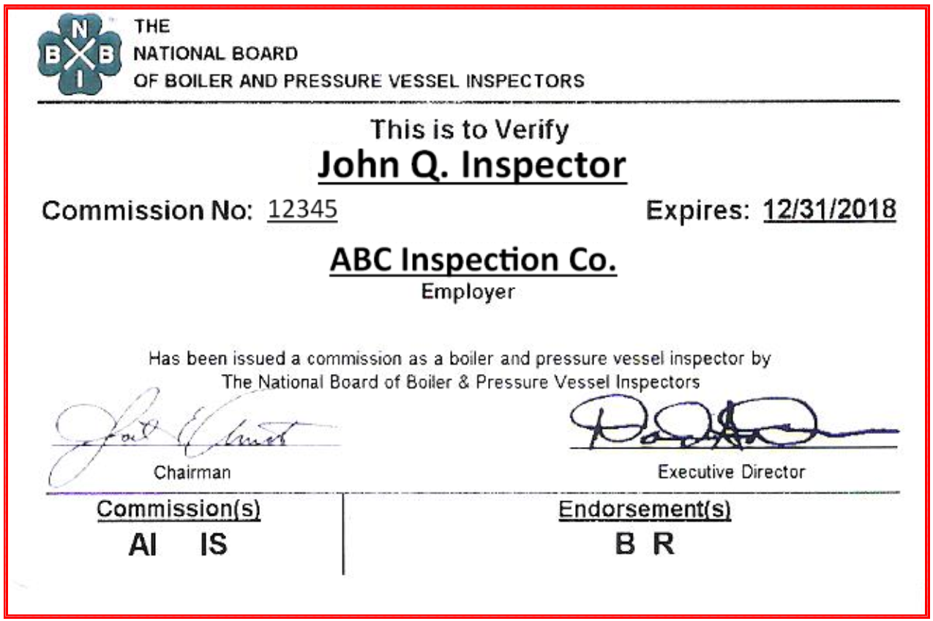


Filling out Application
ABC Inspection Co.
Name of company inspector is employed by as it appears on current National Board Commission card
Check appropriate box:
NB-360 = New Construction (manufacturing)
NB-369 = Inservice Inspections
NB-371 = Owner/User

Slide 4
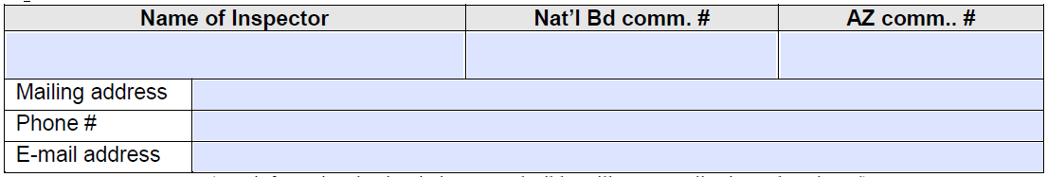
Filling out application
John Q. Inspector
12345
AZ100
5678 Main St., Any Town, USA, 54321
(555) 555-5555
John.inspector@abcinspco.com

Slide 5
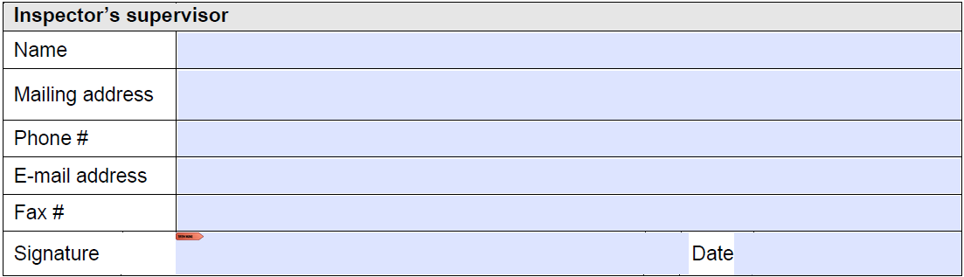
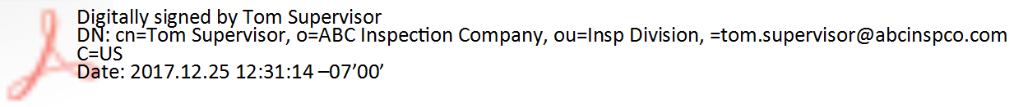
Filling out application
Tom Supervisor
567 Corporate Blvd., Big Town, USA, 98765
(123) 555-4567
tom.supervisor@abcinspco.com
(123) 555-4568
Tom Supervisor
12/25/2017
Typing in your name is not acceptable.
A digital signature will look like this, then you would not have to print out the application. Of course you may actually sign the application by hand also.

Slide 6
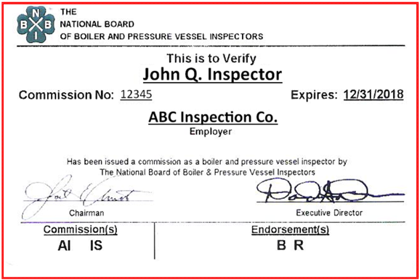
Filling out application
Include a copy of your CURRENT National Board Commission Card
Make sure the date is for the year you are applying for

Slide 7
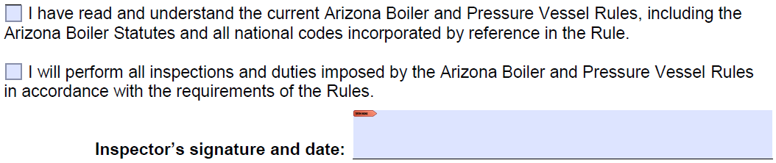


Filling out application
A digital signature will look like this, then you would not have to print out the application. Of course you may actually sign the application by hand also.
Read, Understand, and check these boxes. Not complying with Arizona Boiler Rules is not an option.
Typing in your name is not acceptable, or an option.

Slide 8
Filling out the application
Mail or email the completed application and a copy of the inspectors current National Board Commission card to that which is indicated on the application.
If you have any questions please do not hesitate contacting this office.
If you need Boiler Stickers, or Boiler Numbers to assign new objects please call Steve Harder at (602) 542-1648.
Thank you

